Slide 1
Machine Learning Project
By: Kiera Conway and Robert Chavez

Slide 2
Overview
Section 1 (Presented by Robert Chavez)
Project objective
Background
Machine Learning
Machine Learning in Cyber Security
Introduction To Our Study
Related Work
Dataset Introduction
Dataset Analysis
Section 2 (Presented by Kiera Conway)
Data Preprocessing
Pre-Training Setup
Model – Naïve Bayes
Model – Decision Trees
Model – K-Nearest Neighbors
Model Review
Compare Model Metrics
Conclusion

Slide 3
Project Objective
Our study aims to make a valuable contribution to the discussion on the most effective machine learning algorithm for identifying and filtering out spam messages in SMS communication.
To achieve this, we will explore different methods of detecting spam using an open-source dataset from Kaggle and the Python programming language for preprocessing, training, testing, and analysis.
We will focus on three primary models
Naïve Bayes
Decision Trees/Random Forests
K-Nearest Neighbors (KNN)
Provide a comprehensive comparison of their performance metrics to determine the best approach for accurate classification.
Through our rigorous testing and analysis, we aim to contribute to the ongoing efforts to improve cyber security and help prevent spam messages from causing harm.

Slide 4

Background
Technology has advanced rapidly and with that advancement comes many benefits such as email or SMS messages.
Unfortunately, these systems can be abused by marketers or threat actors via the use of spam or malware.
Spam is unwanted or unsolicited digital communication that gets sent out in bulk.
Threat actors leverage spam methods to send out mass emails or SMS messages as phishing attempts in an effort to obtain PII (personally identifiable information), credit information, and/or unauthorized system access using spam or malware.

Slide 5

Machine Learning - History
Machine learning (ML) is a field of computer science that dates back as early as the 1940’s which researchers first began exploring ways to teach computers to learn from data.
Machine Learning was created to help process these large amounts of data, many of which are too vast for humans to process efficiently.

Slide 6
Machine Learning - Strengths
Machine learning’s strength within it’s machine learning algorithms.
These algorithms allow machine learning to automatically learn from data, identify patterns, and make predictions without the need to being explicitly programmed.
When these algorithms are given large datasets to analyze, they are able to identify underlying patterns and make predictions based on new, unseen data.
Notes:
In other words, instead of being given specific instructions for what to do with the data, machine learning algorithms are designed to learn from patterns in the data itself.

Slide 7
Machine Learning In Cyber Security
Leveraging the ability to learn and adapt to new data makes machine learning particularly versatile and ideal for the constantly evolving nature of Cyber Security.
Historically, rule-based systems were the primary method of detecting threats.
These methods often struggle to identify new and emerging threats, as they rely on pre-defined rule sets that can be easily exploited.
The adaptability of machine learning algorithms enables them to identify anomalies that rule-based methods fall short.

Slide 8

Machine Learning in Cyber Security - Threats
An example of ML's superiority over rule-based systems can be seen in the context of spam detection.
Spam emails and text messages are a major threat to cyber security and have many malicious intentions, including illegally accessing confidential data such as passwords and other important identifiers, spreading malicious software with harmful links or attachments.
By leveraging machine learning we can now lower the attack surface by effectively detecting spam attempts thus minimizing exposure to spam or potential phishing attempts.

Slide 9
Machine Learning in Cyber Security – Spam Identification
To lower the amount of spam we receive in an effort to lower the attack surface or amount of spam one receives we must utilize a spam filter which is usually an application or a rules-based system that identifies the difference between a spam message and a legitimate message.
This process is typically done by a spam filter application reviewing the email or SMS message for anomalies such as misspelled words, malicious links, and other relevant threats. If it finds any of these issues it will either flag the message as spam or alert the user to verify if the spam is indeed spam.
To understand and compare the best methods for filtering spam messages we have selected SMS datasets in which we will leverage spam vs ham algorithms to classify our SMS messages as spam or legitimate (ham).

Slide 10

Machine Learning in Cyber Security – Spam vs Ham
Spam vs ham methods are used for detecting and preventing threats such as spam and phishing attacks.
Using these algorithms allows the system to adapt to new unknown types of spam since it is trivial for an attacker to modify the content of the spam to circumvent the rules-based system.
Although effective they are not perfect as attackers can deliberately craft messages to evade detection by the algorithm.

Slide 11
Related Work
We discovered other researchers have attempted various ML models on similar datasets.
During our review of the related work from other researchers that have made approaches of spam detection using various machine learning methods.We decided to try a couple similar methods of detecting spam while trying other methods that are not commonly used for spam detection.
The results our research will allow us to better understand why other approaches may not offer expected or adequate results when taking accuracy and performance into consideration.
We hope to gain additional insight as to which methods are currently producing the best results while demonstrating methods that may not work for the intended application.

Slide 12
Introduction To Our Study
Dataset
Our data set will consist of the SMS Spam collection data set which will be sourced from University Of California Irvine’s machine learning repository.
https://archive.ics.uci.edu/ml/datasets/SMS+Spam+Collection
Programming language
Python 3
Tools
Kaggle
Jupiyiter notebook
ML Models
K-Nearest neighbors
Naïve bayes
Decision tree/random forest
NLP/NLTK

Slide 13
Methods – Data set information
We have selected the publicly available Kaggle dataset, “Spam (or) Ham ,” to train and test our spam classification models [SpamVHam].
This dataset is a condensed version of The University of California, Irvine’s (UCI) ‘SMS Spam Collection Dataset’
The original message collection was consolidated from various public sources.
425 spam messages from Grumbletext
3,375 ham messages from NUS SMS Corpus (NSC)
450 ham messages from Caroline Tag's PhD Thesis
1,002 ham and 322 spam messages from the SMS Spam Corpus v.0.1 Big
Each message is split between two columns: ‘Class’ which identifies whether it is spam or ham, and ‘sms’ which contains the plain-text version of the message.

Slide 14
Methods – Data Analysis
To prepare our data for use in our ML algorithms we need to review and analyze a series of properties and decide which, if any, transformations were required.
We began by importing the comma-separated values (CSV) data file using the python library, Pandas. Pandas is an open-source python library which is commonly used in machine learning as it helps organize, manipulate, and analyze complex tabular data.
Our process begins through a series of steps, including observing general information, checking for extraneous null values, viewing various observations, and analyzing statistical information.
These are important steps as they are examples of noise which can cause overfitting and potentially “result in more complex models that miss the true pattern”

Slide 15
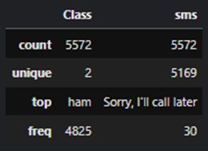
Methods – Data Analysis Continued
The statistical information in Figure 1 also shows the number of possible unique observations:
The most common value.
Frequency of the most common value.
We use this information to determine the completeness of our data, and verify the values contained are expected and acceptable.
As we can see in Figure 1, the amount of unique observations for Class are the expected value of 2 for ‘spam’ and ‘ham.’
We notice sms indicates a unique value of 5169, which is less than the expected 5572; as such, we must conclude that some messages are identical.
This hypothesis is verified with the remaining top and frequency values.
Shows that the most frequent message "Sorry, I'll call later,“ - Occurs 30 times
Since 5572-5169≠30, we must further conclude that there are additional repeated messages.
Within the Class column, these two rows show us that most messages are categorized as `ham`, with 4825 occurrences, which leave the remaining 747 messages to be categorized as `spam`.

Slide 16
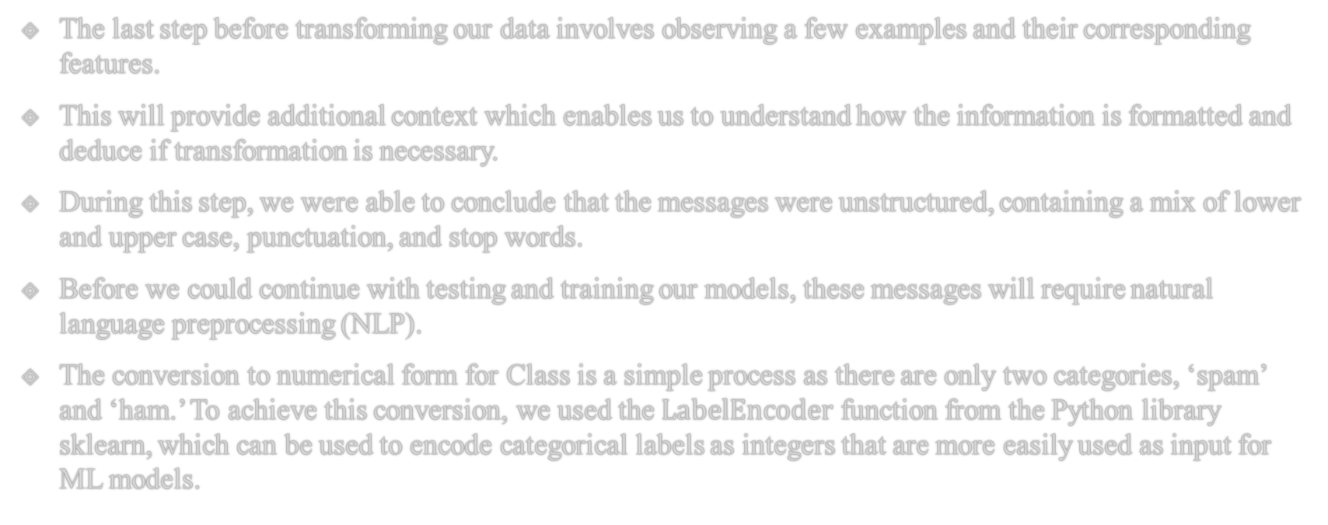
Methods – Data Transformation
The last step before transforming our data involves observing a few examples and their corresponding features.
This will provide additional context which enables us to understand how the information is formatted and deduce if transformation is necessary.
During this step, we were able to conclude that the messages were unstructured, containing a mix of lower and upper case, punctuation, and stop words.
Before we could continue with testing and training our models, these messages will require natural language preprocessing (NLP).
The conversion to numerical form for Class is a simple process as there are only two categories, ‘spam’ and ‘ham.’ To achieve this conversion, we used the $LabelEncoder$ function from the Python library sklearn, which can be used to encode categorical labels as integers that are more easily used as input for ML models.

Slide 17
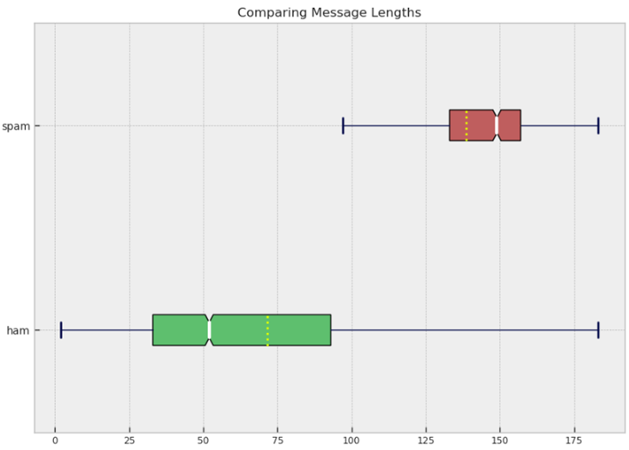
Methods – Data Preparation
This function enabled us to create a new column ‘is_spam’ where we mapped each classification to its corresponding encoded values; each ‘spam’ classification was encoded as a 1 for true, and each ‘ham’ classification was encoded as a 0 for false.
The conversion for the ‘sms’ column is more complicated due to its textual nature and the nuances between legitimate text and spam.
There are many variations between the two columns such as excessive punctuation, web addresses, phone numbers, or promotional content.
Often result in longer, more complex messages.
Figure 2 shows the relationship between message lengths in both spam (red) and ham (green) messages.
As shown by the dotted yellow line in each box plot, spam messages average length of ≈139 is significantly higher than ham messages average length of ≈71.
Figure 2 shows that the entire interquartile range (IQR) of all ham messages in our dataset have message lengths that fall below the minimum value for spam messages, excluding outliers.
This suggests that message length can be a useful feature for distinguishing between spam and ham messages, with longer message lengths being a potential indicator of spam.
As such, we performed feature extraction by creating a new column in our data, sms_len, to capture the message lengths.

Slide 18
Methods - Stopwords
Although message length can provide valuable insights into distinguishing between spam and ham messages, it is not the only feature that can help accurately classify these messages.
In addition to length, the words used in a message are also critical for effective classification.
Not all words carry significance within the context for a message. For example, consider the sentence "I went to the store to buy milk."
We could remove the words "I," "to," and "the," and still convey they original message meaning.
These removed words are called 'stop words’ and they are removed during preprocessing to reduce noise.
This noise can cause bias within a model as stop words occur “very frequently and their presence doesn't have much impact on the sense of the sentence [NLPF].”
The remaining sentence still contains the necessary useful information while being more efficient for the ML algorithms to analyze.
To remove these words from out dataset, we imported the stopword corpus provided by the Natural Language Toolkit (NLTK).
This corpus includes a vast collection of the most frequently occurring words, allowing us to remove them efficiently without manually creating a list.

Slide 19
Methods – Data Preparation
Phone numbers were removed and replaced with a special identifier for two main reasons.
First, phone numbers are often unique and do not provided additional context regarding the text's sentiment or topic. By replacing them with a common ID, we could remove their impact on the model's output while still maintaining a record of their occurrence.
Secondly, we found that engineering a feature identification for phone numbers greatly improved our models’ scores. Later on, when words are converted to a numerical ID, this allowed all phone numbers to be identified as such, instead of each phone number being separate and containing no commonality. This was crucial for the model to identify patterns and correlations between text messages that contain phone numbers.
Another important step in our preprocessing was the removal of punctuation. Instead of a basic punctuation removal process, we opted to replace all occurrences with a space.
This was important because many spam messages include links for victims to follow, and if the punctuation was removed, the links would be joined together and would not be identified as separate words.
For example, by replacing the punctuation with a space, ‘www.here.com' becomes [‘www’, 'here', 'com'] instead of 'wwwherecom'. When words are converted to a numerical ID later, this will enable the common identification of the top-level domains.
If we were to simply remove the punctuation, there would be no commonality between ‘here.com’ and ‘there.com,’ despite both originally containing ‘.com.’ This approach to punctuation removal is more effective in capturing the underlying meaning of text while also retaining essential information that can impact the model's performance.
In the preprocessing phase, it is common to convert all messages to lowercase to ensure consistency in the text. However, we found that certain types of spam messages intentionally use uppercase letters to attract user attention.
By leaving the original letter casing, we are able to provide the algorithm with more information to differentiate between spam and ham messages. For instance, if we converted the ham message “call me now” and the spam message “CALL NOW!” to lowercase, they would look identical (‘call’,’now’) after preprocessing. By preserving the casing, our models are able to recognize the all-caps text as a possible spam message.
Overall, our preprocessing decisions aimed to reduce noise in the dataset while still preserving essential information that can impact the model's output.
By removing stop words, engineering a phone number ID, replacing punctuation with a space, and performing lemmatization to reduce words to their base form, we were able to create a more accurate representation of the underlying meaning of each message.
Once the messages have been preprocessed in this manner, they are saved to a new column named ‘sms_clean’ and are almost ready to be transformed into numerical features for input into the machine learning algorithms.

Slide 20
Methods – Training The Model
Before we can transform our messages, we must first split our training and testing data to avoid overfitting and ensure our models are able accurately predict new, unseen data.
If we do not conduct a train/test split prior to the conversion, we could invertedly introduce bias to our model as it would have access to information from the testing set during the training phase, which it should not have access to.
We will begin by defining our variables, splitting the training and testing data, and then finish executing our data transformation.
The goal of our algorithms is to classify whether a message is spam or ham.
This classification is dependent on each message, the discrete value from ‘is_spam’ becomes our dependent variable y.
The string value from ‘sms_clean’ becomes our independent variable, X.
After identifying and assigning our variables, we split the data into training and testing sets using sklearn's train_test_split function, allocating 75% for training and 25% for testing.
To verify our split was successful, we compared the shapes of our new sets to confirm that our observation and feature values matched.
Training set (X_train and y_train) contained 4179 observations and 1 feature
Testing set (X_test and y_test) contained 1393 observations and 1 feature.
We can verify that these values are correct by noting that 75% of 5572 is 4179 (5572 * 0.75 = 4179) and 25% of 5572 is 1393 (5572 * 0.25 = 1393).
This split ensures that our model is able to accurately predict new, unseen data without being biased by information from the testing set during the training phase. We can now proceed with data transformation after the split to avoid overfitting.

Slide 21
Methods – Training The Model Continued
Word | Count
I’m | 1
going | 2
to | 2
the | 1
store | 1
are | 1
you | 1
join | 1
Our method of categorical conversion utilizes sklearn’s CountVectorizer.
CountVectorizer utilizes our tokenized messages and maps each one to a distinct numerical identification, which it then stores in a sparse matrix.
This technique is commonly known as the bag-of-words (BOW) approach where text data is represented as a "bag" of tokens.
For example, consider our data contained the message “I’m going to the store, are you going to join?” If we left in the stopwords, this approach would produce the matrix shown in Table 1.
Since our dataset is quite large, this method produced a sparse matrix that is 4179 rows × 6859 columns for the training set, and 1393 rows × 6859 columns for the testing set.
Since the row values still match our dependent variables, y_train and y_test, we can confirm the transformation maintained a 75:25 split and was a success.

Slide 22
Models - Overview
After analyzing and preprocessing our dataset, we began training and testing our selected ML algorithms to analyze and classify the messages.
For our analysis, we chose three popular classification algorithms:
Naive Bayes - Naive Bayes is a probabilistic algorithm which “naively assumes independency between features
Decision Tree/Random Forest - Decision Trees create a hierarchical “a tree-like structure” structure of rules to classify data points, while Random Forests extend Decision Trees by combining multiple trees to improve performance
K-Nearest Neighbors (KNN) - KNN classify a data point based on the most common label within a predefined k-nearest neighbors proximity
Each algorithm has unique strengths and weaknesses, and we analyzed their corresponding prediction metrics to explore how they performed on our dataset.
By comparing these results, we were able to determine the most accurate and efficient algorithm for spam/ham classification.

Slide 23
Model – Naïve Bayes
Naive Bayes - is a probabilistic algorithm that employs Bayes' theorem, a mathematical probability formula based on prior evidence.
In the case of spam detection, Naive Bayes computes the probability of an incoming message being spam or ham based on the presence or absence of specific words in the message.
This classifier is often considered naïve because it must assume all features, or words in the message, are equally important and independent of each other.
Naïve Bayes remains a popular method for many text classification tasks, including spam filtering.
When combined with our BOW approach, Naive Bayes can effectively capture the frequency of each word in the message and use it to make predictions.
To implement Naive Bayes, we used sklearn's MultinomialNB, which is specifically designed for text classification tasks like spam filtering.
After fitting our model to the training data, we made predictions on the test data and used these to create a confusion matrix and calculate the accuracy score.
Our confusion matrix shows
We correctly classified 1197 ham messages and 176 spam messages
Only 10 false positives and negatives.
The accuracy score of 0.9856 indicates that our Naive Bayes model performed well on this task.

Slide 24
Model – Descion Tree
Decision Tree - Decision Trees create a hierarchical structure of fixed rules to classify data points.
The algorithm begins at the root of the structure and recursively splits the data based on the decisions made at the internal feature nodes, where each node corresponds to a decision or question about a feature, and each edge represents a possible answer.
The resulting values of these decisions are indicated by edges, which lead to other internal nodes or leaves, which represent a final classification [AIML].
This node-edge traversal repeats until the algorithm reaches a leaf or other stopping criterion, such as a maximum depth or a minimum number of samples per leaf.
At each leaf, the algorithm outputs the predicted class label for the data point that was passed down through the decision tree.
Random Forest - are an extension of Decision Trees, in which they combine multiple trees to improve performance and reduce overfitting.
Instead of using a single tree, the algorithm creates a collection of trees by randomly selecting a subset of features and data points for each tree.
Each tree performs an its own classification and the final prediction is then determined by combining all of the predictions, such as by taking the majority vote [AIML].

Slide 25
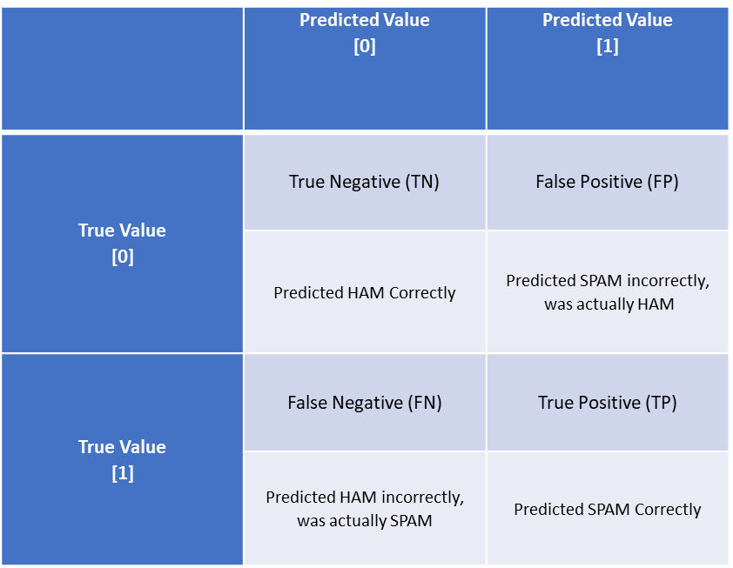
Mode – Confusion Matrix
For our code, we used the sklearn functions DecisionTreeClassifier and RandomForestClassifier to create and fit multiple models, including a standard tree model, a model with entropy, a pre-pruned model with entropy, and a Random Forest model.
After fitting and training each model, we evaluated their performance through a series of predictions on the test set, which were then used to calculate a confusion matrix and accuracy score.
The accuracy score is the proportion of correct predictions out of all predictions made. Table 2 shows the layout of a confusion matrix, which provides the number of true positives (TP), true negatives (TN), false positives (FP), and false negatives (FN) for each model.

Slide 26
Models – Tree Classifier Performance
Our initial Decision Tree Classifier, which utilized function defaults, achieved an accuracy score of 97.84% with 162 TP’s and 6 FP’s indicating that the model incorrectly classified 24 FN.
While this is within an acceptable range, it was lower than the accuracy score obtained by the Naive Bayes model (98.56%).
As such, we experimented with different hyperparameters, including the criterion, specified as entropy or Gini impurity, and the maximum depth for pre-pruning, to increase model metrics.
Since our default model utilizes Gini impurity, we selected the entropy criterion to improve the accuracy. The entropy criterion differs from the Gini impurity in that it measures the level of information gained by each split in the decision tree; alternatively, Gini impurity measures the probability of a data point being misclassified.
While the entropy model performed equally at identifying TP (162 correct), it was much less accurate at identifying TN (1197 correct vs 1201 correct).
The accuracy score for this model decreased to 97.55% and we continued experimenting in an attempt to recreate a model which increased accuracy without a loss in TN.
Next, pre-pruning was implemented to limit excess tree growth and prevent overfitting. Unfortunately, pre-pruning the Decision Tree classifier was still unable to improve overall accuracy and scored 97.63%.
By limiting the tree from over-fitting, this model became more successful than our Entropy model, and the same as our original model at identifying Ham messages (1201 correct vs 1201 correct in original model vs 1197 in entropy model). However, this model was less successful than both of the other models at identifying spam messages (159 correct vs 162 correct in original model and entropy models).
Since the model increased from our entropy model in correct ham identification, but decreased in correct spam identification, the accuracy score was between our Entropy and Gini models at 97.63%. As the aim was to increase our overall accuracy and without sacrificing TP, we attempted a random forest next.
Random Forests provided the highest accuracy score between the decision trees, scoring a 97.91%. By using multiple decision trees to make predictions, this model became more successful than all of our other decision tree models and achieved the highest TN values with no FP.
While the TP score predicted was less than the other models, the TN increased significantly more than the TP decreased
Thus, random forests provide the highest accuracy score - increasing from our original 97.84% to 97.98%.
A summation of these values are shown in Table 3.
Model Name | Accuracy Score | TP | TN | FP | FN
Gini (Standard) Model | 0.978464 | 162 | 1201 | 6 | 24
Entropy Model | 0.975592 | 162 | 1197 | 10 | 24
Pre-Pruned Model | 0.976310 | 159 | 1201 | 6 | 27
Random Forest | 0.979899 | 158 | 1207 | 0 | 28

Slide 27
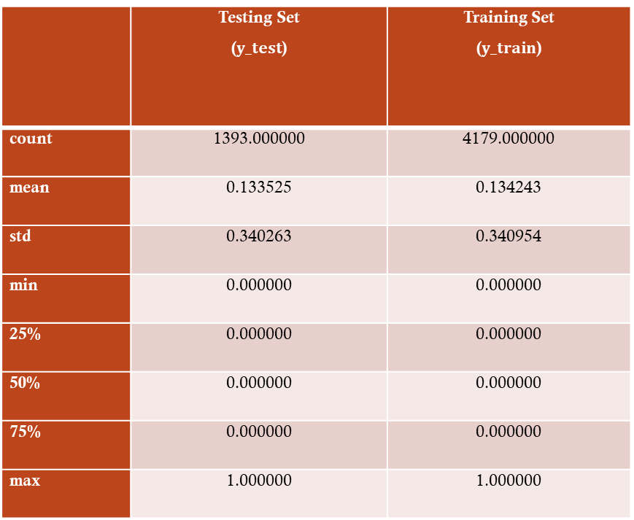
Models – K Nearest Neighbors
K-Nearest Neighbors (KNN) - is a classification algorithm that determines the class of an observation based on its proximity, defined as the Euclidean distance or straight line between two points, to its nearest neighbors within a region [AIML].
The value of k represents the number of neighbors to consider and may be calculated multiple ways.
A common method for selecting k is to calculate the square root of the number of observations in the training set, as used in our initial KNN model.
As shown in Table 4, when we observe the testing and training metrics of our dependent variable, y, we can see that the majority of observations are ham and contain the value '0’.
When there is this imbalance of data, using the square root method to calculate k may result in a bias towards the majority class.
This is because the majority class will have more neighbors and therefore influence the classification more than the minority class.
As a result, our KNN square root model scored a below average accuracy of 86.64%, which suggests that we may need to explore alternative methods for calculating k.
 | Testing Set ($y_test$) | Training Set ($y_train$)
count | 1393.000000 | 4179.000000
mean | 0.133525 | 0.134243
std | 0.340263 | 0.340954
min | 0.000000 | 0.000000
25% | 0.000000 | 0.000000
50% | 0.000000 | 0.000000
75% | 0.000000 | 0.000000
max | 1.000000 | 1.000000

Slide 28
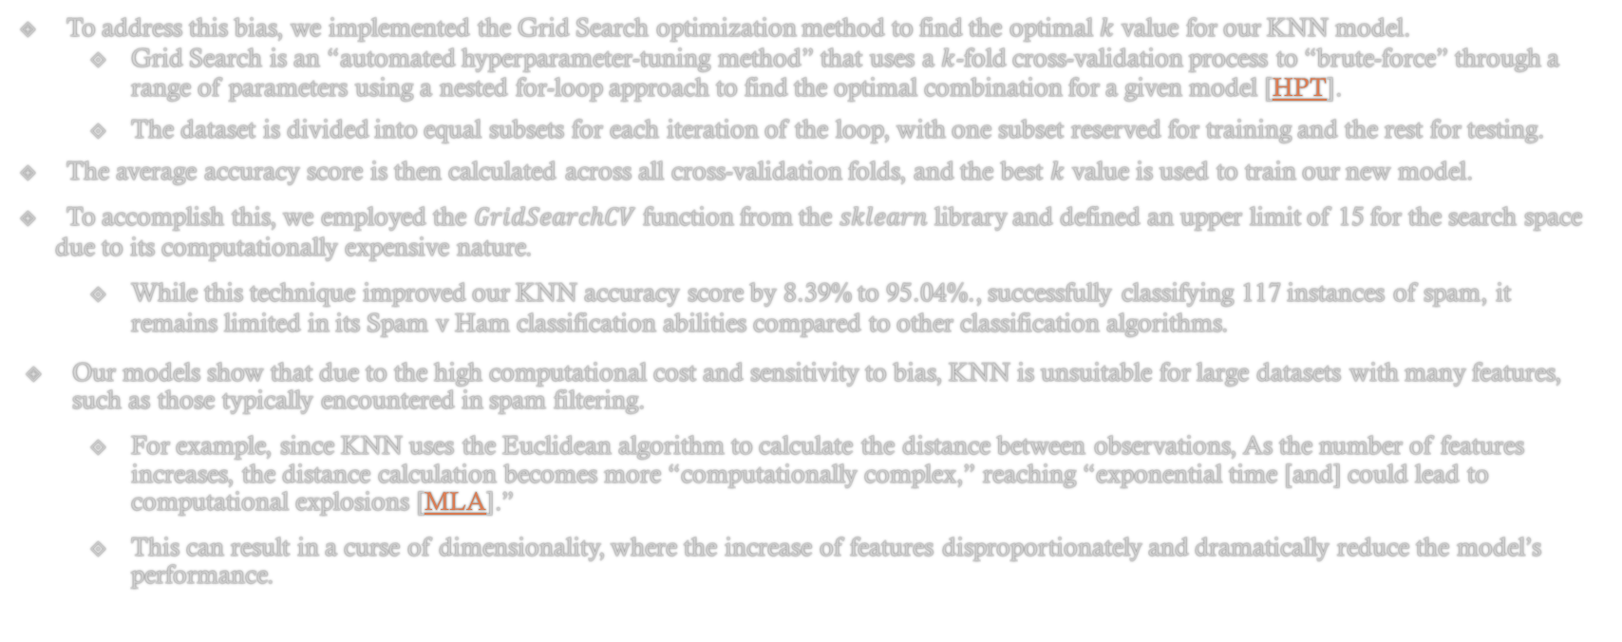
Models – K Nearest Neighbors Bias
To address this bias, we implemented the Grid Search optimization method to find the optimal $k$ value for our KNN model.
Grid Search is an “automated hyperparameter-tuning method” that uses a $k$-fold cross-validation process to “brute-force” through a range of parameters using a nested for-loop approach to find the optimal combination for a given model [HPT].
The dataset is divided into equal subsets for each iteration of the loop, with one subset reserved for training and the rest for testing.
The average accuracy score is then calculated across all cross-validation folds, and the best $k$ value is used to train our new model.
To accomplish this, we employed the $GridSearchCV$ function from the $sklearn$ library and defined an upper limit of 15 for the search space due to its computationally expensive nature.
While this technique improved our KNN accuracy score by 8.39% to 95.04%., successfully classifying 117 instances of spam, it remains limited in its Spam v Ham classification abilities compared to other classification algorithms.
Our models show that due to the high computational cost and sensitivity to bias, KNN is unsuitable for large datasets with many features, such as those typically encountered in spam filtering.
For example, since KNN uses the Euclidean algorithm to calculate the distance between observations, As the number of features increases, the distance calculation becomes more “computationally complex,” reaching “exponential time [and] could lead to computational explosions [MLA].”
This can result in a curse of dimensionality, where the increase of features disproportionately and dramatically reduce the model’s performance.

Slide 29
Results

Slide 30
Conclusion

Slide 31
Questions

